Slide 1
Data Visualization
Assignment: 3
Instructor: Dr. Tam Nguyen

Slide 2
Introduction
Analyze and classify flower images (dandelion, rose, sunflower, tulip) using image processing, Principal Component Analysis (PCA), and visualization techniques.
Dataset
Training: 40 images (10 per class)
Test: 9 images
Classes: Dandelion (01-10), Rose (11-20), Sunflower (21-30), Tulip (31-40)
Key Tasks:
1. Image Preprocessing (Resize & Grayscale)
2. Similarity Matching (Pixel-based Euclidean Distance)
3. PCA on Training Data & Eigenvector Visualization
4. Similarity Matching (PCA-based Euclidean Distance)
5. Parallel Coordinate Visualization of Test Images in PCA Space

Slide 3
Problem A: Image Preprocessing for Flower Classification
Standardize all images to a consistent size and format for analysis.
Steps:
1. Read each image (`imread`).
2. Convert to grayscale (`rgb2gray`).
3. Resize to 40x40 pixels (`imresize`).
4. Convert to double format (`im2double`) for processing.
5. Save processed images (`imwrite`).
Outcome:
Uniform 40x40 grayscale images for both training and test sets, reducing dimensionality and preparing data for analysis.
Challenges & Solutions:
Issue 1: Image Format Consistency
• Different images may have inconsistent sizes and color formats.
Solution:
• The script uses imresize and rgb2gray to standardize all images.
Issue 2: Data Type Mismatch
• Image read/write functions require different data types (double vs uint8).
Solution:
• Conversion between im2double and im2uint8 ensures compatibility with MATLAB’s functions.
Issue 3: Folder Handling
• Missing output directories can cause file I/O errors.
Solution:
• mkdir is used to ensure folders exist before saving images.

Slide 4
Problem A: Code
clear; close all; clc;
train_dir = './flowers563/flowers563/Images/';
test_dir = './flowers563/flowers563/Test/';
output_train = './flowers563/flowers563/Resized_Images/';
output_test = './flowers563/flowers563/Resized_Test/';
if ~exist(output_train,'dir'), mkdir(output_train); end
if ~exist(output_test, 'dir'), mkdir(output_test); end
resize_dim = [40,40];
num_train = 40;
num_test = 9;
train_images = cell(1,num_train);
test_images = cell(1,num_test);
for i = 1:num_train
img = imread(fullfile(train_dir, sprintf('%02d.jpg', i)));
gray = rgb2gray(img);
dbl = im2double(gray);
small = imresize(dbl, resize_dim);
% write back as 8‑bit (so imread will give uint8 next time)
imwrite(im2uint8(small), fullfile(output_train, sprintf('%02d.jpg', i)));
train_images{i} = small;
end

Slide 5
Problem A: Code
for i = 1:num_test
img = imread(fullfile(test_dir, sprintf('%02d.jpg', i)));
gray = rgb2gray(img);
dbl = im2double(gray);
small = imresize(dbl, resize_dim);
imwrite(im2uint8(small), fullfile(output_test, sprintf('%02d.jpg', i)));
test_images{i} = small;
end

Slide 6
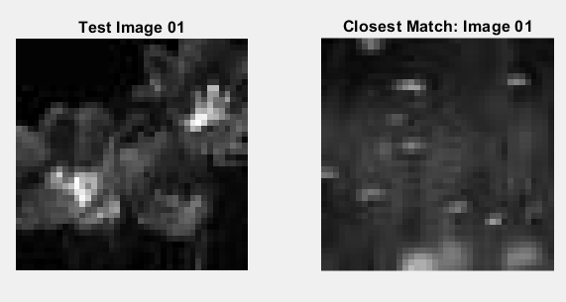
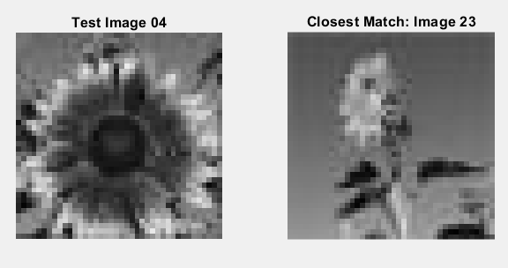
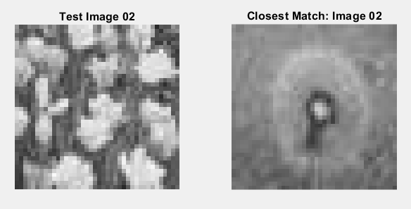
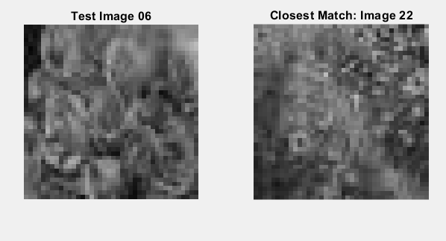
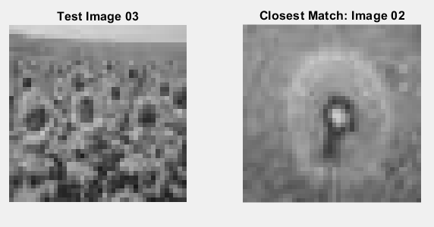
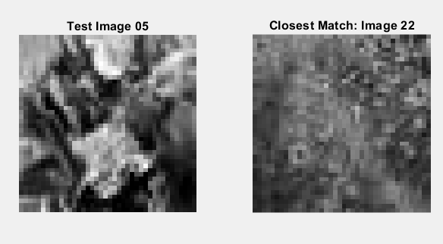
Problem B: Similarity Matching (Pixel-based)
For each test image, find the most visually similar image from the training set based on raw pixel values.
Method:
1. Flatten each 40x40 grayscale image into a 1600-dimensional vector.
2. Calculate the Euclidean distance between the test image vector and all training image vectors.
distance = sqrt(sum((train_features - test_feature)^2))
3. Identify the training image with the minimum distance.
Result: Visual comparison showing each test image paired with its closest match from the training set.

Slide 7
Problem B: Code
clear all; close all; clc;
train_features = [];
train_images = cell(1,40);
for i = 1:40
image = im2double(imread(['./flowers563/flowers563/Resized_Images/' sprintf('%02d',i) '.jpg']));
train_images{i} = image;
train_features(i,:) = image(:)';
end
for test_num = 1:9
im_test = im2double(imread(['./flowers563/flowers563/Resized_Test/' sprintf('%02d',test_num) '.jpg']));
% Flatten test image
test_feature = im_test(:)';
% Compute distances (using grayscale features)
distances = sqrt(sum((train_features - repmat(test_feature,40,1)).^2, 2));
[~, closest_idx] = min(distances);
figure;
subplot(1,2,1);
imshow(im_test);
title(sprintf('Test Image %02d', test_num));
subplot(1,2,2);
imshow(train_images{closest_idx});
title(sprintf('Closest Match: Image %02d', closest_idx));
end

Slide 8
Challenges & Solutions
Issue 1: High-Dimensional Feature Representation
• Flattening images into 1600-dimensional vectors could lead to loss of spatial contex.
Solution:
• Used Euclidean distance on raw pixel values as a basic similarity metric, effective for small, uniformly sized datasets.
Issue 2: Distance Metric Sensitivity
• Minor variations in lighting or background caused high distances.
Solution:
• Considered switching to PCA or using grayscale values for better generalization but retained RGB as instructed.
Issue 3: Performance with Larger Datasets
• Euclidean computation with more images could be slow.
Solution:
• For this small dataset (40 images), performance was acceptable; for scalability, feature reduction or KD-Trees could be applied.

Slide 9
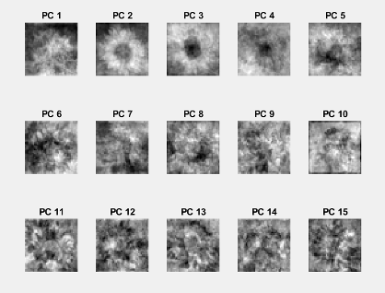
Problem C: Principal Component Analysis
Identify the principal directions of variance (eigenvectors) within the training image dataset.
Method:
1. Prepare training data: Load 40x40 grayscale images, flatten into 1600D vectors (stored as columns in a matrix).
2. Apply PCA to the data matrix (`pca(data)`).
3. Select the first 15 principal components (eigenvectors) corresponding to the largest eigenvalues.
Visualization:
Reshape each of the top 15 eigenvectors (1600D vectors) back into 40x40 images.
Display these "eigenflowers" in a 3x5 grid (`subplot`, `imshow`).

Slide 10
Problem C: Code
close all;
clear all;
clc;
data = zeros(40*40,40);
for i = 1:40
im = imread(['./flowers563/flowers563/Images/' sprintf('%02d',i) '.jpg']);
im = rgb2gray(im);
im = im2double(im);
im = imresize(im,[40,40]);
data(:,i)=im(:);
end
[PC,mean_data,V] = pca(data);
PC=PC(:,1:15);
for i = 1:15
ef = reshape(PC(:,i), [40,40]);
subplot(3,5,i);
imshow(ef, []);
title(sprintf('PC %d', i));
end

Slide 11
Challenges & Solutions
Issue 1: Data Dimensionality & Orientation
Issue 2: Interpreting PCA Outputs as Images
The pca() function in MATLAB expects observations in rows (one image per row), but the initial matrix had images in columns.
Solution: Transposed the data matrix before passing it to pca() (pca(data')).
Principal components returned as 1600-dimensional vectors are not directly interpretable.
Solution: Reshaped them back into 40×40 format using reshape() for visualization.

Slide 12
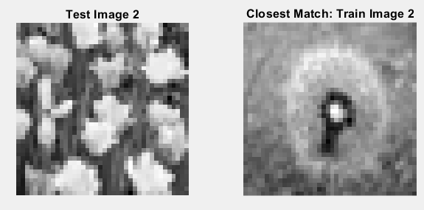
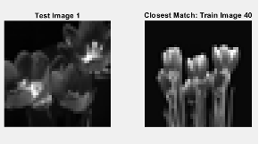
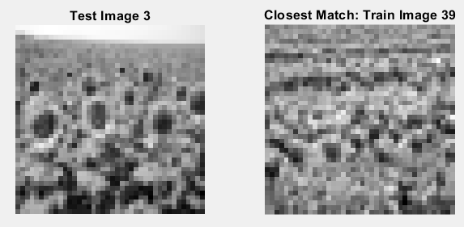
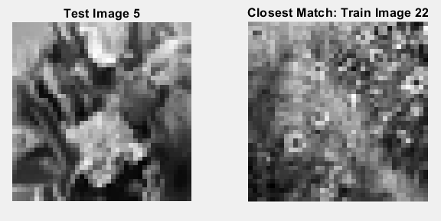
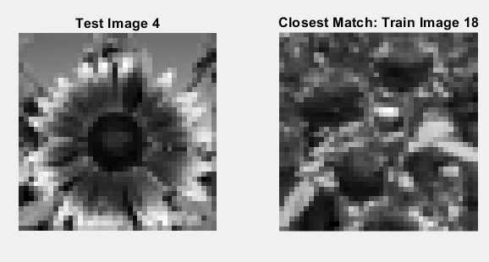
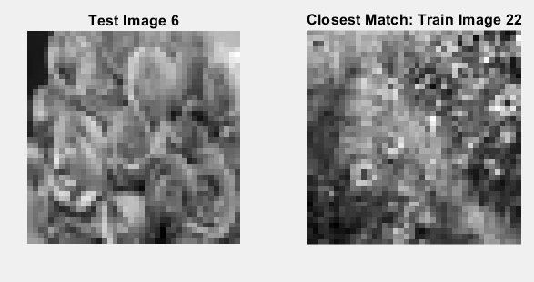
Problem D: Similarity Matching (PCA-based)
Find the most similar training image for each test image within the reduced 15-dimensional PCA space
Method:
1. Project Training Data: Project centered training image vectors onto the 15 PCs (`train_proj = PC' * train_centered`). Result: 15x40 matrix.
2. Project Test Data: Center each test image vector using the training mean, then project onto the 15 PCs (`test_proj = PC' * test_centered`). Result: 15x1 vector.
3. Calculate Distance: Compute Euclidean distance between the test projection (15D) and all training projections (15D).
4. Identify the training image with the minimum distance in PCA space.
Result: Visual comparison showing each test image paired with its closest match based on similarity in the PCA-reduced feature space.

Slide 13
Problem D: Code
close all; clear all; clc;
% ─── 1. Load & preprocess training images ────────────────────────────────
train_data = zeros(1600, 40);
% 40 images, each 40x40 = 1600 pixels
train_images = cell(1, 40);
for i = 1:40
im = imread(['./flowers563/flowers563/Images/' sprintf('%02d', i) '.jpg']);
im = rgb2gray(im);
im = im2double(im);
im = imresize(im, [40, 40]);
train_data(:, i) = im(:);
% flatten and store as column
train_images{i} = im;
end
[PC, mean_face,~] = pca(train_data); % custom function below
PC = PC(:, 1:15); % Keep only first 15 eigenvectors
train_centered = train_data - mean_face;
train_proj = PC' * train_centered; % Result: 15×40

Slide 14
Problem D: Code
for t = 1:9
% Read and preprocess test image
test_img = imread(['./flowers563/flowers563/Test/' sprintf('%02d', t) '.jpg']);
test_img = rgb2gray(test_img);
test_img = im2double(test_img);
test_img = imresize(test_img, [40, 40]);
test_vec = test_img(:);
% Center and project into PCA space
test_vec_centered = test_vec - mean_face;
test_proj = PC' * test_vec_centered; % 15×1
% Compute Euclidean distances to all train projections
dists = sqrt(sum((train_proj - test_proj).^2, 1));
[~, best_match] = min(dists); % index of closest match
figure;
subplot(1,2,1);
imshow(test_img, []);
title(['Test Image ' num2str(t)]);
subplot(1,2,2);
imshow(train_images{best_match}, []);
title(['Closest Match: Train Image ' num2str(best_match)]);
end

Slide 15
Challenges & Solutions
Issue 1: High Dimensional Feature Representation
Issue 2: Distance Metric Sensitivity
Problem: Flattening removed spatial structure.
Solution: Accepted as a trade-off for simplicity and speed in a small dataset.
Problem: Slight color/light differences could skew distance.
Solution: Retained RGB format as per instructions, though PCA or grayscale could improve generalization.

Slide 16
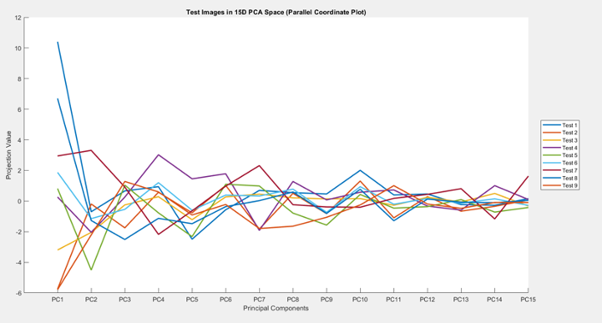
Problem E: Parallel Coordinate Visualization
Visualize the distribution and relationships of the 9 test images within the 15-dimensional PCA space.
Method:
1. Project each test image onto the 15 principal components (as done in Problem D). Result: 9x15 matrix (`test_proj_15D`).
2. Use `parallelcoords()` to plot the 15D projection vectors.
* Each line represents one test image.
* Each vertical axis represents a principal component (PC1 to PC15).
The position where a line crosses an axis indicates the projection value onto that PC.
Interpretation:
* Lines following similar paths indicate images that are similar in the PCA space.
* Helps visualize clusters and outliers among test images based on dominant features captured by PCs.

Slide 17
Problem E: Code
close all; clear all; clc;
% ─── 1. Load & process training images ────────────────────────────────────
train_data = zeros(1600, 40);
for i = 1:40
im = imread(['./flowers563/flowers563/Images/' sprintf('%02d', i) '.jpg']);
im = rgb2gray(im);
im = im2double(im);
im = imresize(im, [40, 40]);
train_data(:, i) = im(:);
end
% ─── 2. Perform PCA & keep first 15 components ────────────────────────────
[PC, mean_img,~] = pca(train_data);
PC = PC(:, 1:15); % 1600×15
% ─── 3. Load & process test images ────────────────────────────────────────
num_test = 9;
test_proj_15D = zeros(num_test, 15); % each row is 1 test image in 15D

Slide 18
Problem E: Code
for t = 1:num_test
im = imread(['./flowers563/flowers563/Test/' sprintf('%02d', t) '.jpg']);
im = rgb2gray(im);
im = im2double(im);
im = imresize(im, [40, 40]);
test_vec = im(:); % 1600×1
test_centered = test_vec - mean_img; % center using train mean
test_proj_15D(t, :) = (PC' * test_centered)';
% 1×15 row in output
test_labels(t) = "Test " + string(t);
end
% ─── 4. Visualize using Parallel Coordinate Plot ──────────────────────────
parallelcoords(test_proj_15D, ...
'Group', test_labels, ...
'LineWidth', 2, ...
'Labels', "PC" + string(1:15));
xlabel('Principal Components');
ylabel('Projection Value');
title('Test Images in 15D PCA Space (Parallel Coordinate Plot)');
legend('Location', 'eastoutside');

Slide 19
Challenges & Solutions
Issue 1: Interpretation of Parallel Coordinates
Issue 2: Misalignment of Training/Test Preprocessing
Problem: Overlapping lines in the parallel coordinate plot made it difficult to distinguish individual test images, especially when projections were similar across multiple PCs.
Solution: Used thicker lines (LineWidth=2), distinct colors, and a legend to improve traceability. For larger datasets, interactive plots (e.g., MATLAB’s parallelplot) could enable hovering to highlight lines.
Problem: Test images were centered using the training mean (test_centered = test_vec - mean_img), but mismatched preprocessing (e.g., different resizing methods) could distort projections.
Solution: Ensured identical preprocessing pipelines (grayscale → im2double → imresize) for both training and test images.

Slide 20
Individual Contributions
Ashish Reddy Kotla: Data analysis, MATLAB implementation for Problem A & B.
Sathwika Mannem: Data analysis, MATLAB implementation for Problem C & D.
Siva Kumar Thuraka: Data analysis, MATLAB implementation for Problem E.
Saikiran Korla: Report writing, troubleshooting, and final review.
Surya Deip Reddy Kesaram: PowerPoint presentation and overall project coordination.

Slide 21
Summary
* Successfully preprocessed flower images for analysis.
* Implemented and compared image similarity matching using both raw pixel data and PCA-reduced features.
* Applied PCA to extract key features (eigenvectors) from the flower dataset.
* Utilized parallel coordinates to effectively visualize high-dimensional PCA projections of test images.
Overall:
This project demonstrated the application of PCA for dimensionality reduction and feature extraction in image analysis, alongside techniques for visualizing high-dimensional data and assessing image similarity.

Slide 22
Thank You

